Slide 1
Distributed Systems
Fault Tolerance
Chapter 8

Slide 2
Course/Slides Credits
Note: all course presentations are based on those developed by Andrew S. Tanenbaum and Maarten van Steen. They accompany their "Distributed Systems: Principles and Paradigms" textbook (1st & 2nd editions).
http://www.prenhall.com/divisions/esm/app/author_tanenbaum/custom/dist_sys_1e/index.html
And additions made by Paul Barry in course CW046-4: Distributed Systems
http://glasnost.itcarlow.ie/~barryp/net4.html

Slide 3
Fault Tolerance Basic Concepts
Dealing successfully with partial failure within a Distributed System.
Being fault tolerant is strongly related to what are called dependable systems.
Dependability implies the following:
  Availability
  Reliability
  Safety
  Maintainability

Slide 4
Dependability Basic Concepts
Availability – the system is ready to be used immediately.
Reliability – the system can run continuously without failure.
Safety – if a system fails, nothing catastrophic
will happen.
Maintainability – when a system fails, it can
be repaired easily and quickly (sometimes, without its users noticing the failure).

Slide 5
But, What Is “Failure”?
A system is said to “fail” when it cannot meet its promises.
A failure is brought about by the existence
of “errors” in the system.
The cause of an error is a “fault”.

Slide 6
Types of Fault
There are three main types of ‘fault’:
Transient Fault – appears once, then disappears.
Intermittent Fault – occurs, vanishes, reappears; but: follows no real pattern
(worst kind).
Permanent Fault – once it occurs, only the replacement/repair of a faulty component
will allow the DS to function normally.

Slide 7
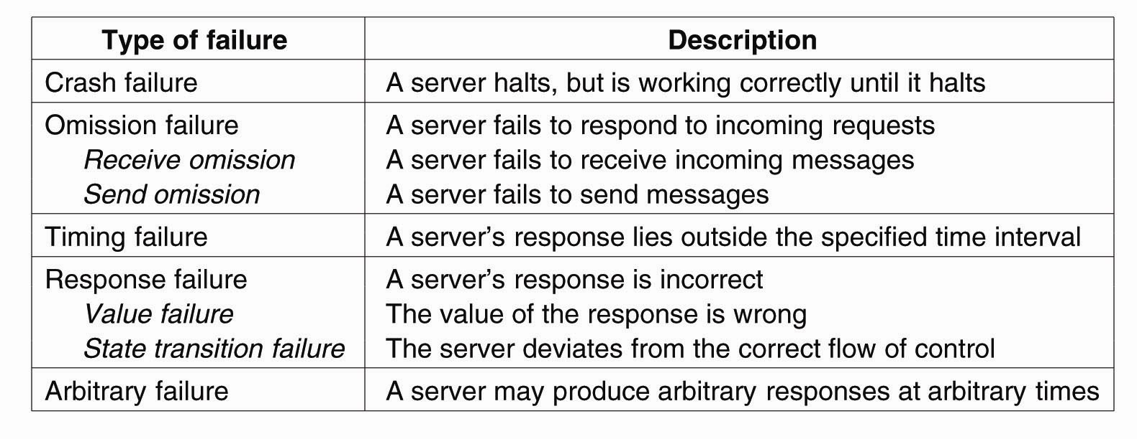
Failure Models

Slide 8
Failure Masking by Redundancy
Strategy: hide the occurrence of failure from other processes using redundancy.
Three main types:
Information Redundancy – add extra bits to allow for error detection/recovery (e.g., Hamming codes and the like).
Time Redundancy – perform operation and, if needs be, perform it again. Think about how transactions work (BEGIN/END/COMMIT/ABORT).
Physical Redundancy – add extra (duplicate) hardware and/or software to the system.

Slide 9
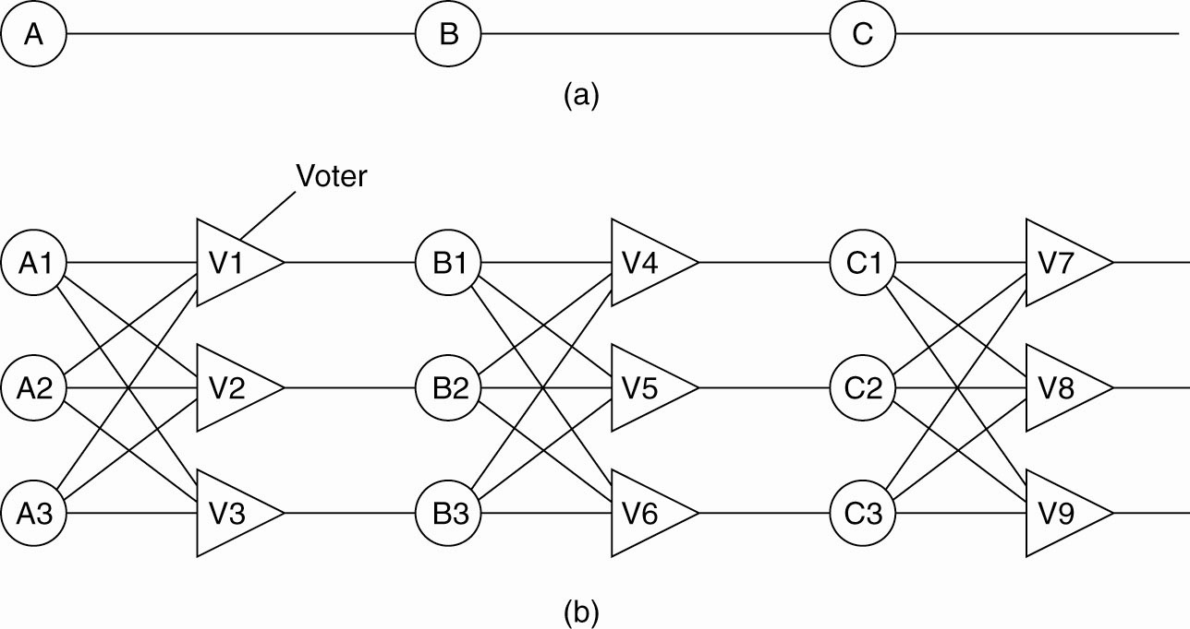
Failure Masking by Redundancy
Triple modular redundancy

Slide 10
DS Fault Tolerance Topics
Process Resilience
Reliable Client/Server Communications
Reliable Group Communication
Distributed Commit
Recovery Strategies

Slide 11
Process Resilience
Processes can be made fault tolerant by arranging to have a group of processes, with each member of the group being identical.
A message sent to the group is delivered to all of the “copies” of the process (the group members), and then only one of them performs the required service.
If one of the processes fail, it is assumed that one of the others will still be able to function (and service any pending request or operation).

Slide 12
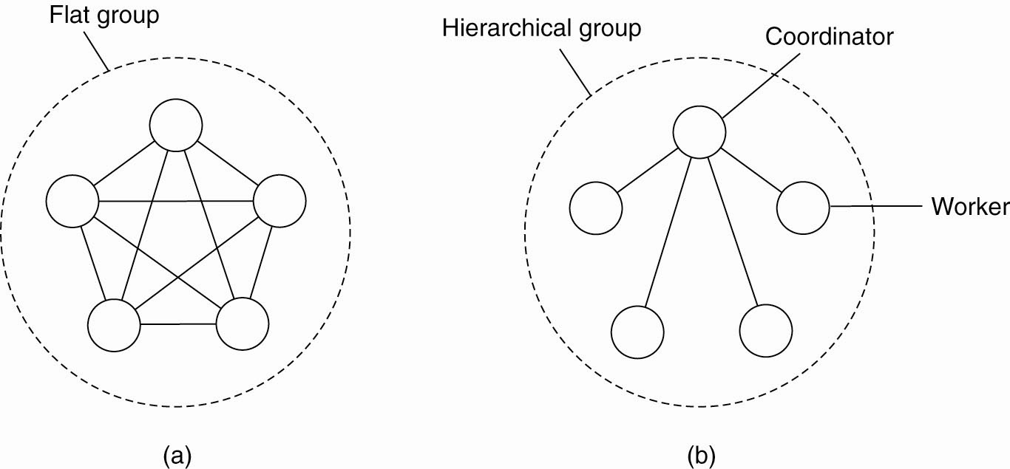
Flat Groups versus Hierarchical Groups
(a) Communication in a flat group.
(b) Communication in a simple hierarchical group.

Slide 13
Failure Masking and Replication
By organizing a fault tolerant group of processes, we can protect a single vulnerable process.
There are two approaches to arranging the replication of the group:
  Primary (backup) Protocols
  Replicated-Write Protocols

Slide 14
The Goal of Agreement Algorithms
“To have all non-faulty processes reach consensus on some issue (quickly).”
The two-army problem.
Even with non-faulty processes, agreement between even two processes is not possible in the face of unreliable communication.

Slide 15
History Lesson: The Byzantine Empire
Time: 330-1453 AD.
Place: Balkans and Modern Turkey.
Endless conspiracies, intrigue, and untruthfulness were alleged to be common practice in the ruling circles of the day (sounds strangely familiar … ).
That is: it was typical for intentionally wrong and malicious activity to occur among the ruling group.
A similar occurrence can surface in a DS, and is
known as ‘Byzantine failure’.
Question: how do we deal with such malicious group members within a distributed system?

Slide 16
Agreement in Faulty Systems (1)
Possible cases:
Synchronous (lock-step) versus asynchronous systems.
Communication delay is bounded (by globaly and predetermined maximum time) or not.
Message delivery is ordered (in real-time) or not.
Message transmission is done through unicasting or multicasting.

Slide 17
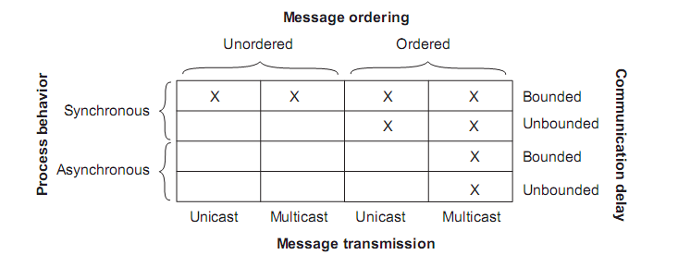
Agreement in Faulty Systems (2)
Circumstances under which distributed
agreement can be reached

Slide 18
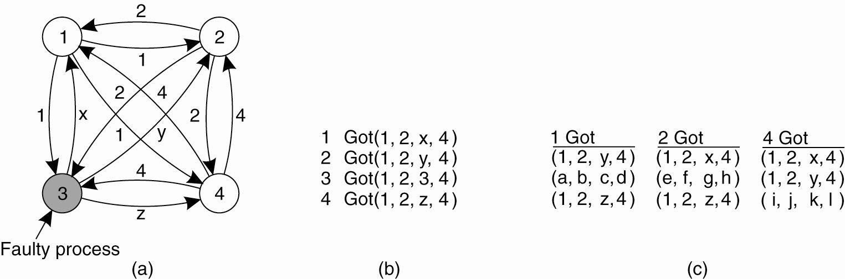
Agreement in Faulty Systems (3)
The Byzantine agreement problem for three
non-faulty and one faulty process. (a) Each process sends their value to the others.

Slide 19
Agreement in Faulty Systems (4)
The Byzantine agreement problem for three non-faulty and one faulty process. (b) The vectors that each process assembles based on (a).
(c) The vectors that each process receives in step 3.

Slide 20
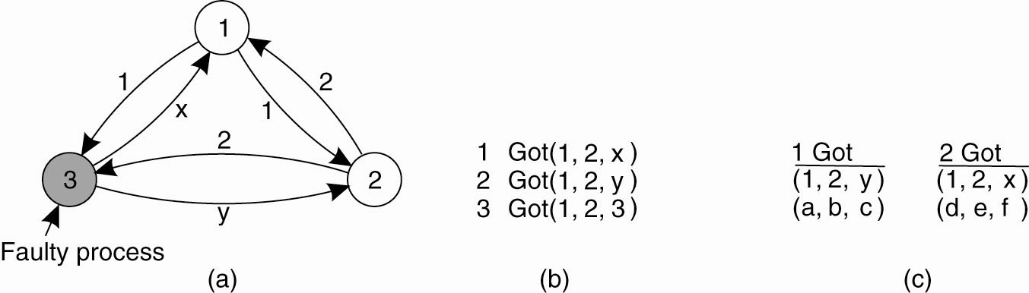
Agreement in Faulty Systems (5)
The same as before, except now with two
correct process and one faulty process

Slide 21
Reliable Client/Server Communications
In addition to process failures, a communication channel may exhibit crash, omission, timing, and/or arbitrary failures.
In practice, the focus is on masking crash and omission failures.
For example: the point-to-point TCP masks omission failures by guarding against lost messages using ACKs and retransmissions. However, it performs poorly when a crash occurs (although a DS may try to mask a TCP crash by automatically re-establishing the lost connection).

Slide 22
RPC Semantics and Failures
The RPC mechanism works well as long as both the client and server function perfectly.
Five classes of RPC failure can be identified:
The client cannot locate the server, so no request can be sent.
The client’s request to the server is lost, so no response is returned by the server to the waiting client.
The server crashes after receiving the request, and the service request is left acknowledged, but undone.
The server’s reply is lost on its way to the client, the service has completed, but the results never arrive at the client
The client crashes after sending its request, and the server sends a reply to a newly-restarted client that may not be expecting it.

Slide 23
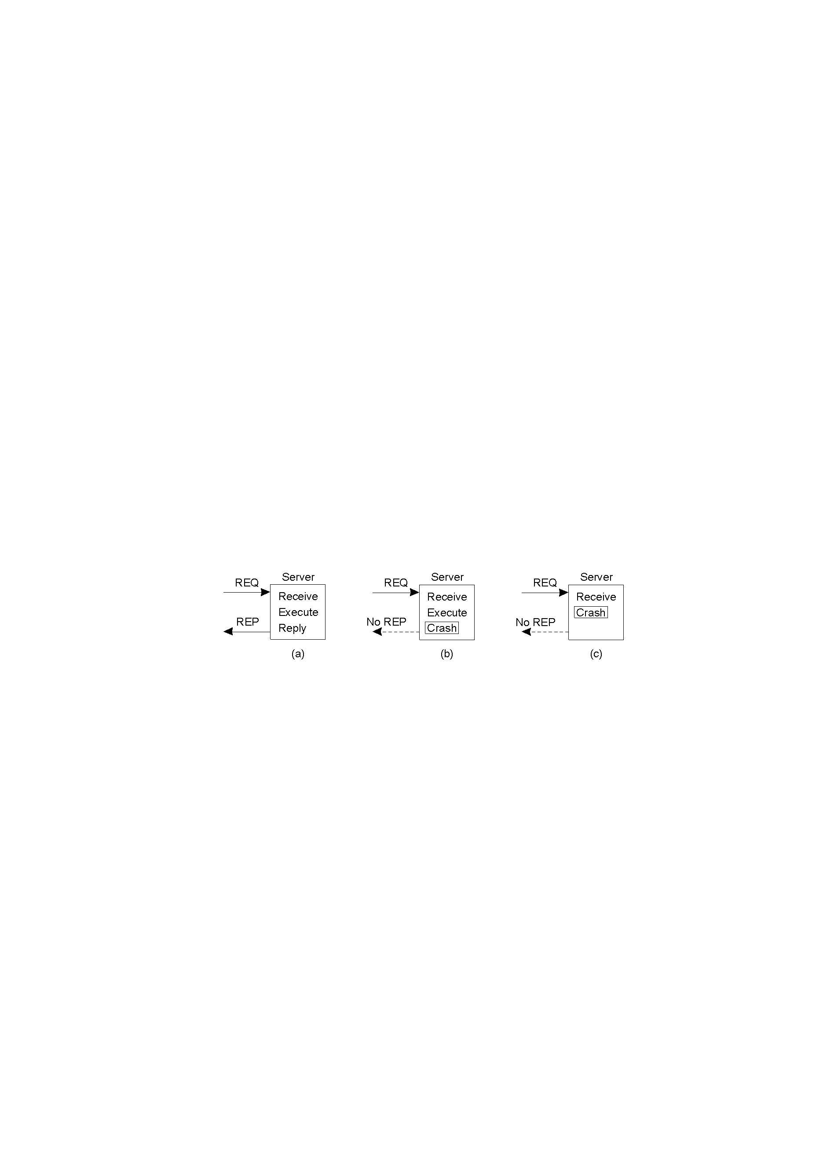
The Five Classes of Failure (1)
A server in client-server communication:
The normal case.
Crash after service execution.
Crash before service execution.

Slide 24
The Five Classes of Failure (2)
An appropriate exception handling mechanism can deal with a missing server. However, such technologies tend to be very language-specific, and they also tend to be non-transparent (which is a big
DS ‘no-no’).
Dealing with lost request messages can be dealt with easily using timeouts. If no ACK arrives in time, the message is resent. Of course, the server needs to be able to deal with the possibility of duplicate requests.

Slide 25
The Five Classes of Failure (3)
Server crashes are dealt with by implementing one of three possible implementation philosophies:
  At least once semantics: a guarantee is given that the RPC occurred at least once, but (also) possibly more that once.
  At most once semantics: a guarantee is given that the RPC occurred at most once, but possibly not at all.
  No semantics: nothing is guaranteed, and client and servers take their chances!
It has proved difficult to provide exactly once semantics.

Slide 26
Server Crashes (1)
Remote operation: print some text and (when done) send a completion message.
Three events that can happen at the server:
Send the completion
message (M),
Print the text (P),
Crash (C).

Slide 27
Server Crashes (2)
These three events can occur in six different orderings:
M →P →C: A crash occurs after sending the completion message and printing the text.
M →C (→P): A crash happens after sending the completion message, but before the text could be printed.
P →M →C: A crash occurs after sending the completion message and printing the text.
P→C(→M): The text printed, after which a crash occurs before the completion message could be sent.
C (→P →M): A crash happens before the server could do anything.
C (→M →P): A crash happens before the server could do anything.

Slide 28
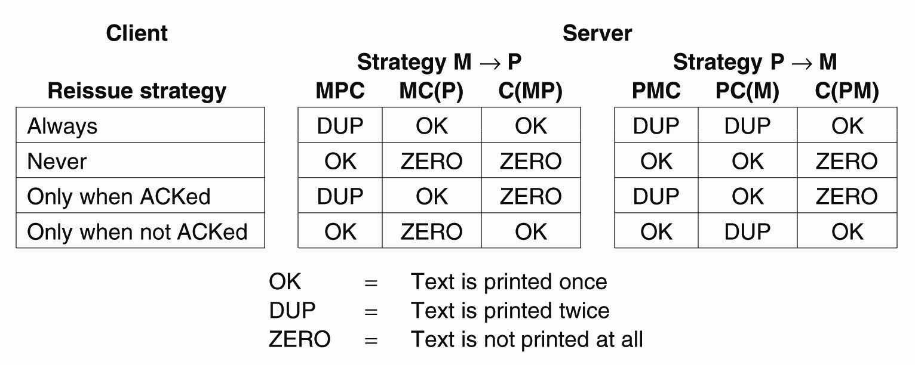
Server Crashes (3)
Different combinations of client and server strategies in the presence of server crashes

Slide 29
The Five Classes of Failure (4)
Lost replies are difficult to deal with.
Why was there no reply? Is the server dead, slow, or did the reply just go missing? Emmmmm?
A request that can be repeated any number of times without any nasty side-effects is said to be idempotent. (For example: a read of a static web-page is said to be idempotent).
Nonidempotent requests (for example, the electronic transfer of funds) are a little harder to deal with. A common solution is to employ unique sequence numbers. Another technique is the inclusion of additional bits in a retransmission to identify it as such to the server.

Slide 30
The Five Classes of Failure (5)
When a client crashes, and when an ‘old’ reply arrives, such a reply is known as an orphan.
Four orphan solutions have been proposed:
  extermination (the orphan is simply killed-off).
  reincarnation (each client session has an epoch associated with it, making orphans easy to spot).
  gentle reincarnation (when a new epoch is identified, an attempt is made to locate a requests owner, otherwise the orphan is killed).
  expiration (if the RPC cannot be completed within a standard amount
  of time, it is assumed to have expired).
In practice, however, none of these methods are desirable for dealing with orphans. Research continues …

Slide 31
Reliable Group Communication
Reliable multicast services guarantee that all messages are delivered to all members of a process group.
Sounds simple, but is surprisingly tricky (as multicasting services tend to be inherently unreliable).
For a small group, multiple, reliable point-to-point channels will do the job, however, such a solution scales poorly as the group membership grows. Also:
  What happens if a process joins the group
  during communication?
  Worse: what happens if the sender of the multiple, reliable point-to-point channels crashes half way through sending the messages?

Slide 32
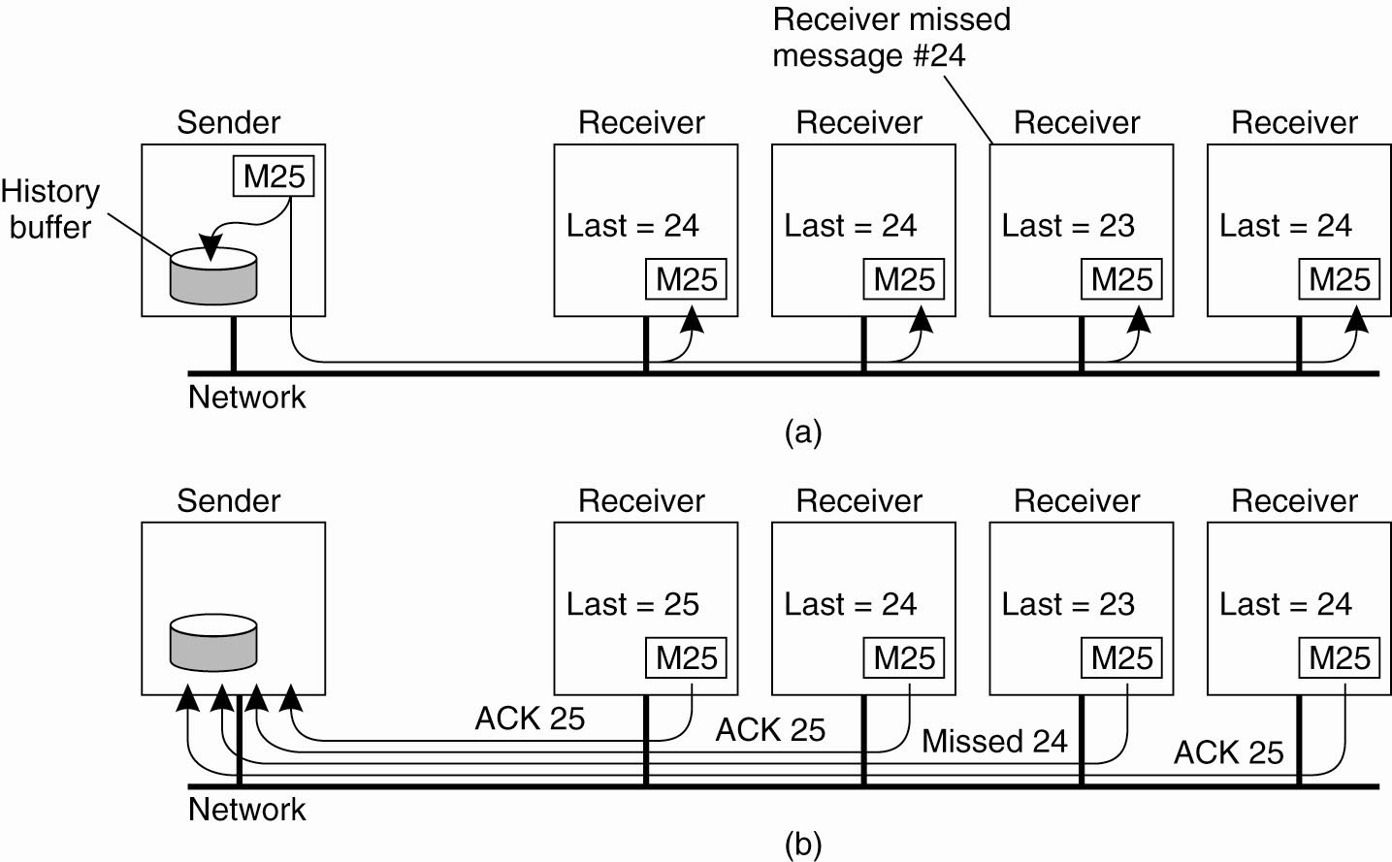
Basic Reliable-Multicasting Schemes
A simple solution to reliable multicasting when all receivers are known and are assumed not to fail.
(a) Message transmission. (b) Reporting feedback.

Slide 33
SRM: Scalable Reliable Multicasting
Receivers never acknowledge successful delivery.
Only missing messages are reported.
NACKs are multicast to all group members.
This allows other members to suppress their feedback, if necessary.
To avoid “retransmission clashes”, each member is required to wait a random delay prior to NACKing.

Slide 34
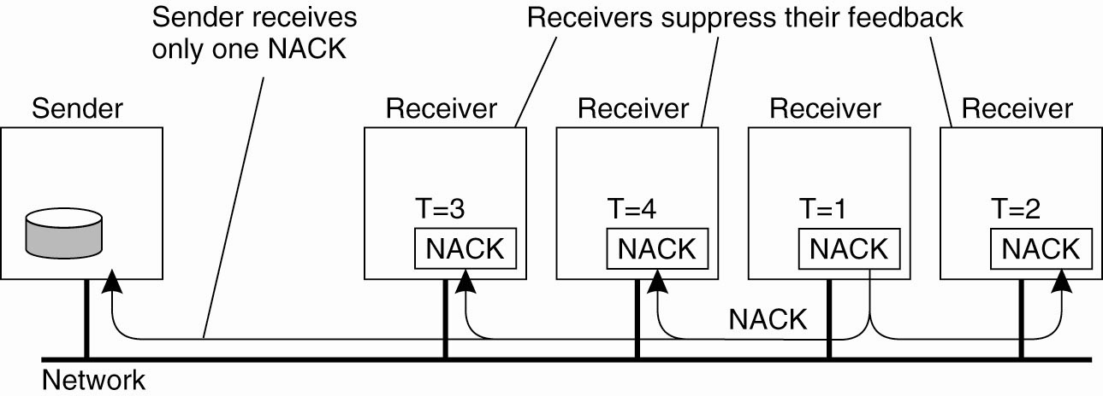
Nonhierarchical Feedback Control
Several receivers have scheduled a request for retransmission, but the first retransmission request leads to the suppression of others

Slide 35
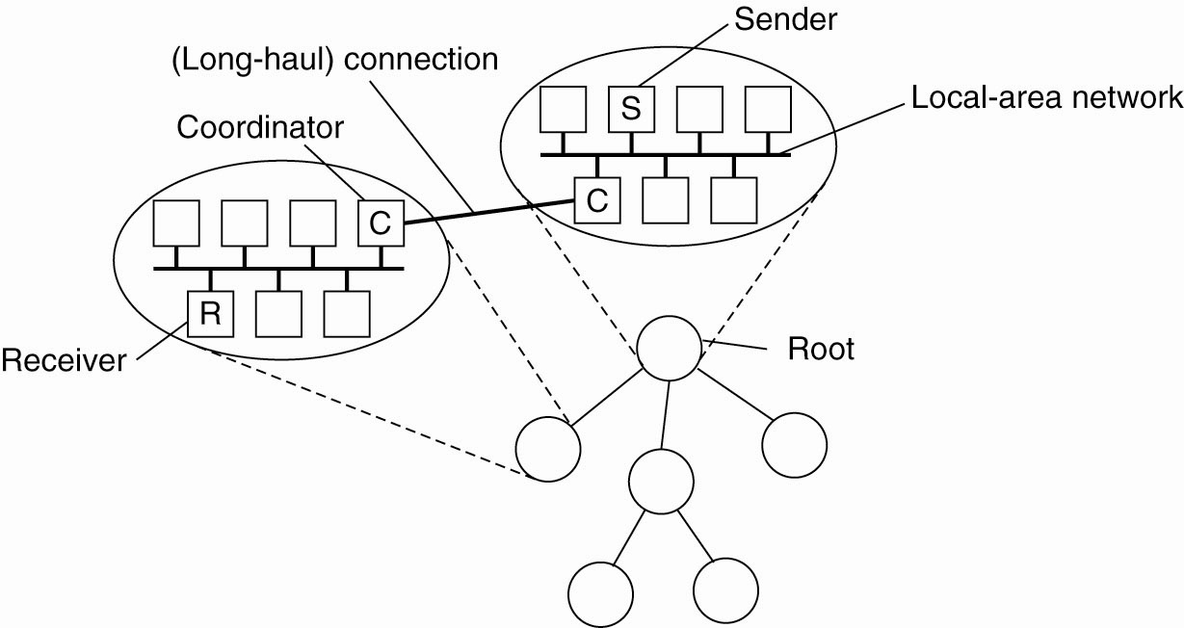
Hierarchical Feedback Control
The essence of hierarchical reliable multicasting.
Each local coordinator forwards the message to its children and later handles retransmission requests.

Slide 36
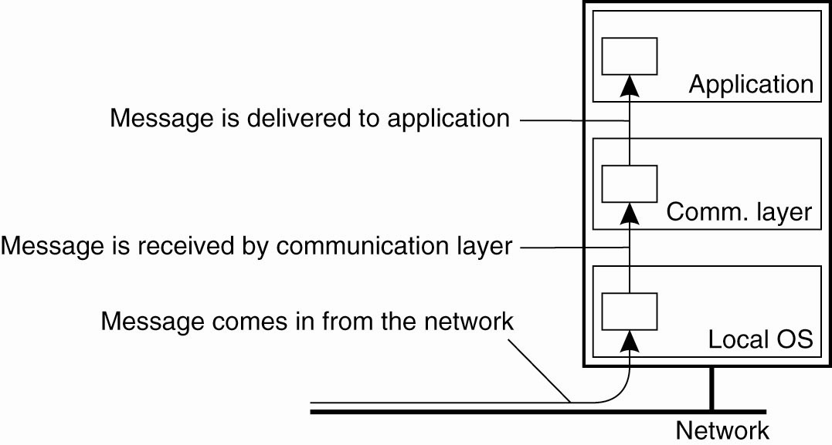
Virtual Synchrony (1)
The logical organization of a distributed system
to distinguish between message receipt and message delivery.

Slide 37
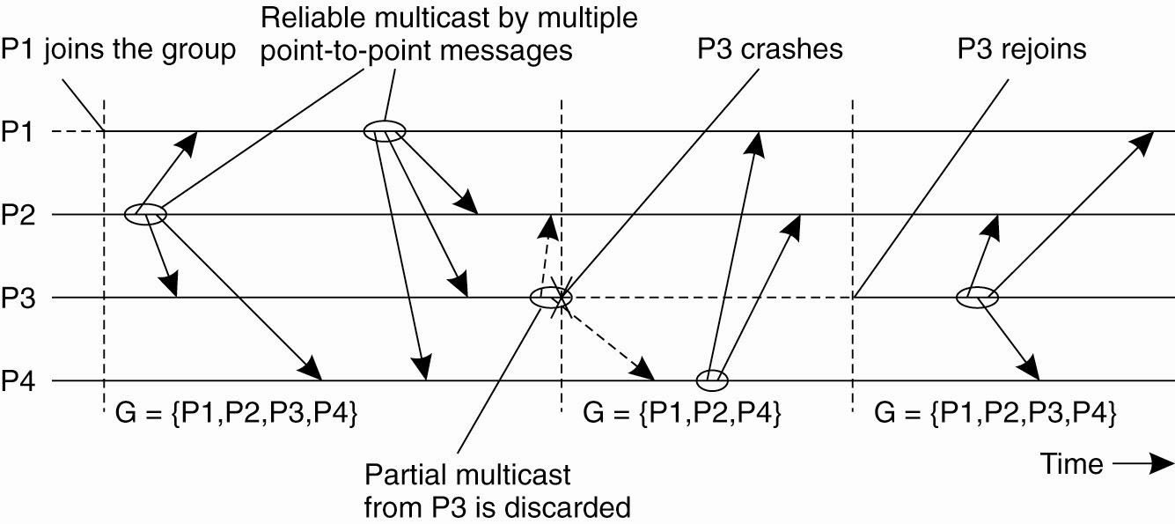
Virtual Synchrony (2)
The principle of virtual synchronous multicast

Slide 38
Message Ordering (1)
Four different orderings are distinguished:
Unordered multicasts
FIFO-ordered multicasts
Causally-ordered multicasts
Totally-ordered multicasts

Slide 39
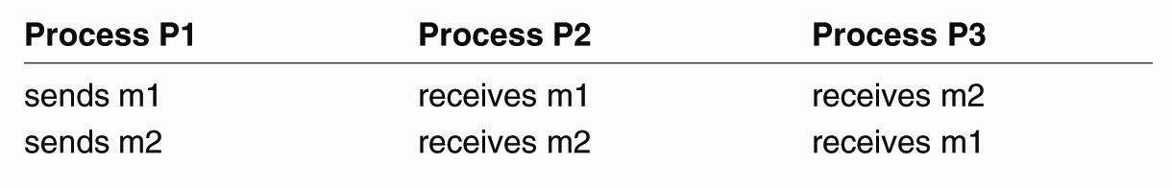
Message Ordering (2)
Three communicating processes in the same group. The ordering of events per process is shown along the vertical axis.

Slide 40
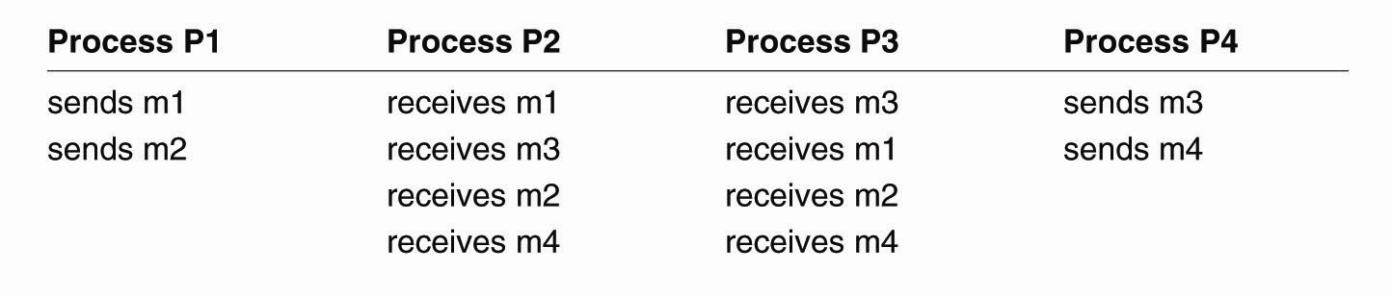
Message Ordering (3)
Four processes in the same group with two different senders, and a possible delivery order of messages under FIFO-ordered multicasting

Slide 41
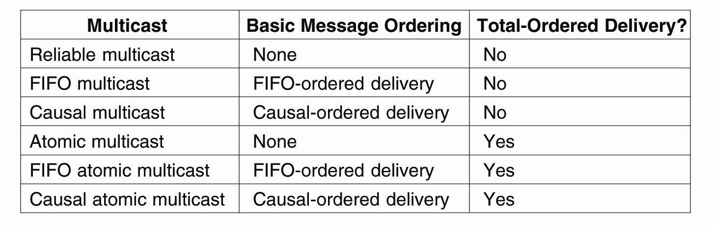
Implementing Virtual Synchrony (1)
Six different versions of virtually
synchronous reliable multicasting

Slide 42
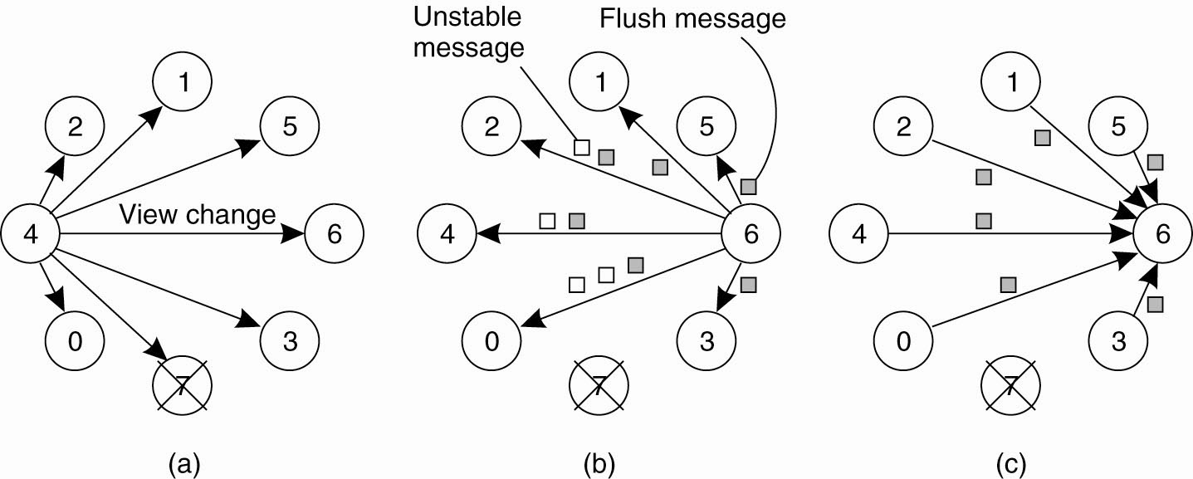
Implementing Virtual Synchrony (2)
(a) Process 4 notices that process 7 has crashed and sends a view change

Slide 43
Implementing Virtual Synchrony (3)
(b) Process 6 sends out all its unstable messages, followed by a flush message

Slide 44
Implementing Virtual Synchrony (4)
(c) Process 6 installs the new view when it has received a flush message from everyone else

Slide 45
Distributed Commit
General Goal:
  We want an operation to be performed by all group members, or none at all.
  [In the case of atomic multicasting, the operation is the delivery of the message.]
There are three types of “commit protocol”:
single-phase commit
two-phase commit
three-phase commit

Slide 46
Commit Protocols
One-Phase Commit Protocol:
  An elected coordinator tells all the other processes to perform the operation in question.
But, what if a process cannot perform the operation? There’s no way to tell the coordinator! Whoops …
The solutions:
  The Two-Phase and Three-Phase Commit Protocols.

Slide 47
The Two-Phase Commit Protocol
First developed in 1978!!!
Summarized: GET READY, OK, GO AHEAD.
The coordinator sends a VOTE_REQUEST message to all group members.
The group member returns VOTE_COMMIT if it can commit locally, otherwise VOTE_ABORT.
All votes are collected by the coordinator. A GLOBAL_COMMIT is sent if all the group members voted to commit. If one group member voted to abort, a GLOBAL_ABORT is sent.
The group members then COMMIT or ABORT based on the last message received from the coordinator.

Slide 48
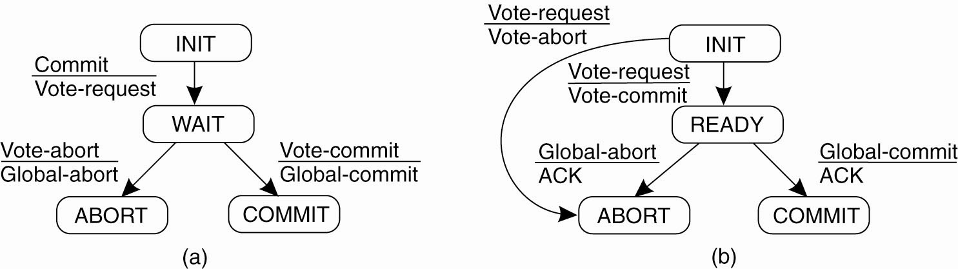
Two-Phase Commit (1)
(a) The finite state machine for the coordinator in 2PC.
(b) The finite state machine for a participant.

Slide 49
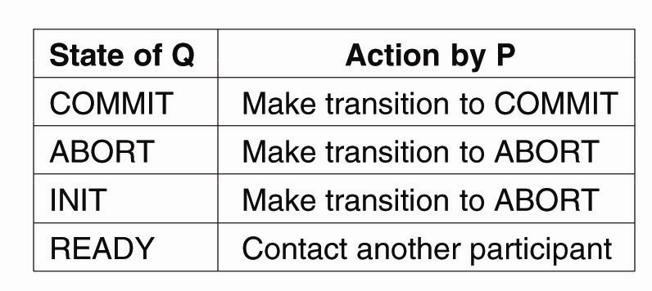
Two-Phase Commit (2)
Actions taken by a participant P when residing in state READY and having contacted another participant Q

Slide 50
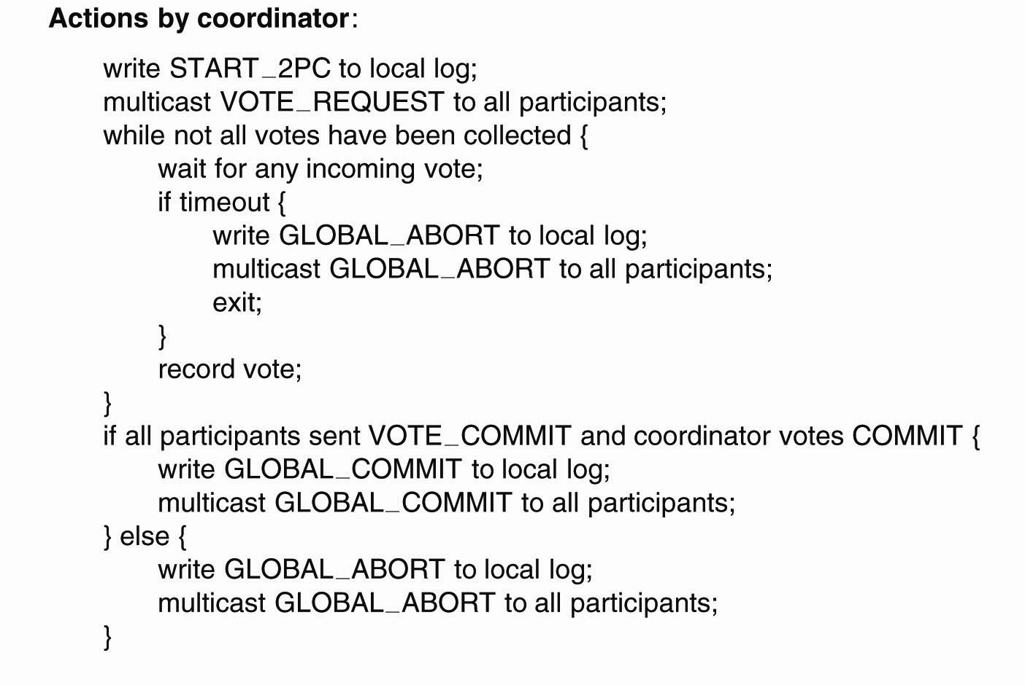
Two-Phase Commit (3)
. . .
Outline of the steps taken by the
coordinator in a two-phase commit protocol

Slide 51
Two-Phase Commit (4)
. . .
Outline of the steps taken by the
coordinator in a two-phase commit protocol

Slide 52
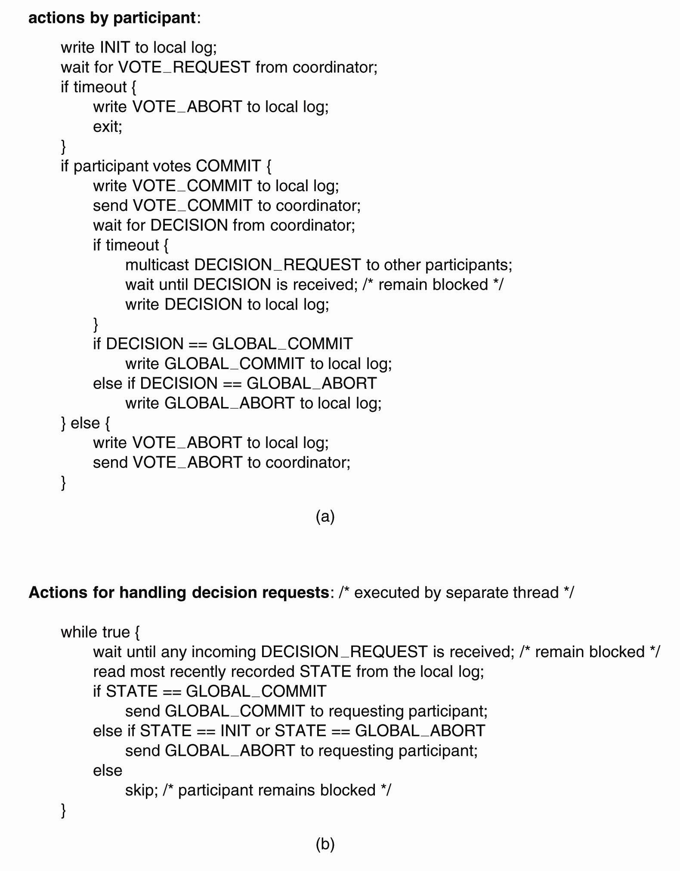
Two-Phase Commit (5)
(a) The steps taken by a participant process in 2PC

Slide 53
Two-Phase Commit (6)
(b) The steps for handling incoming decision requests

Slide 54
Big Problem with Two-Phase Commit
It can lead to both the coordinator and the group members blocking, which may lead to the dreaded deadlock.
If the coordinator crashes, the group members may not be able to reach a final decision, and they may, therefore, block until the coordinator recovers …
Two-Phase Commit is known as a blocking-commit protocol for this reason.
The solution? The Three-Phase Commit Protocol.

Slide 55
Three-Phase Commit (1)
The states of the coordinator and each participant satisfy the following two conditions:
There is no single state from which it is possible to make a transition directly to
either a COMMIT or an ABORT state.
There is no state in which it is not possible
to make a final decision, and from which a transition to a COMMIT state can be made.

Slide 56
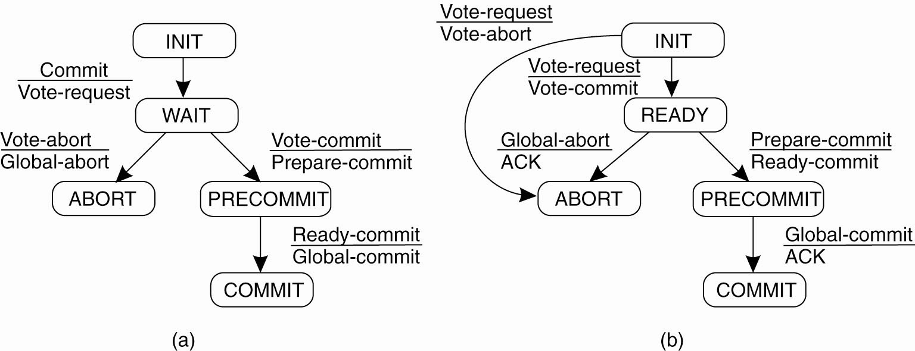
Three-Phase Commit (2)
(a) The finite state machine for the coordinator in 3PC.
(b) The finite state machine for a participant.

Slide 57
Recovery Strategies
Once a failure has occurred, it is essential that the process where the failure happened recovers to a correct state.
Recovery from an error is fundamental to fault tolerance.
Two main forms of recovery:
Backward Recovery: return the system to some previous correct state (using checkpoints), then continue executing.
Forward Recovery: bring the system into a correct state, from which it can then continue to execute.

Slide 58
Forward and Backward Recovery
Major disadvantage of Backward Recovery:
  Checkpointing can be very expensive (especially when errors are very rare).
  [Despite the cost, backward recovery is implemented more often. The “logging” of information can be thought of as a type of checkpointing.].
Major disadvantage of Forward Recovery:
  In order to work, all potential errors need to be accounted for up-front.
  When an error occurs, the recovery mechanism then knows what to do to bring the system forward to a correct state.

Slide 59
Recovery Example
Consider as an example:
Reliable Communications
Retransmission of a lost/damaged packet is an example of a backward recovery technique.
When a lost/damaged packet can be reconstructed as a result of the receipt of other successfully delivered packets, then this is known as Erasure Correction. This is an example of a forward recovery technique.

Slide 60
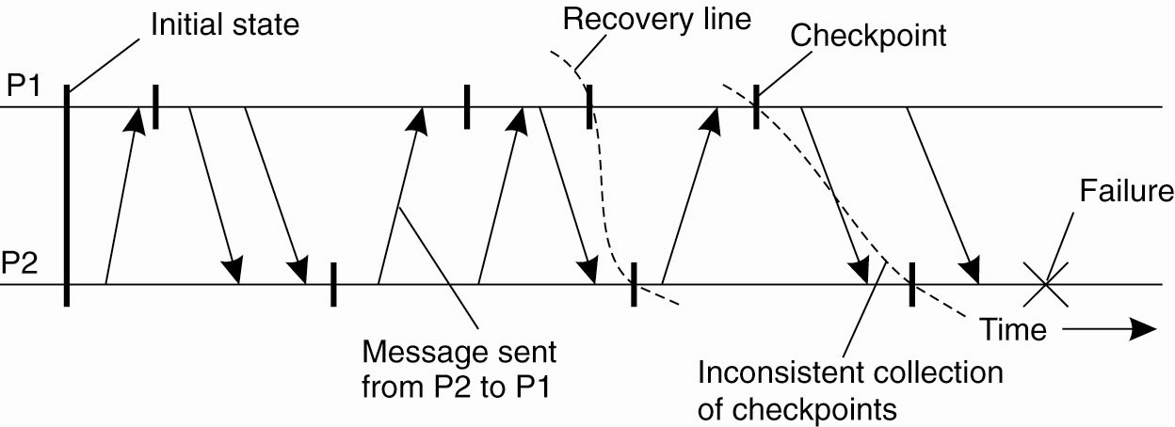
Checkpointing
A recovery line

Slide 61
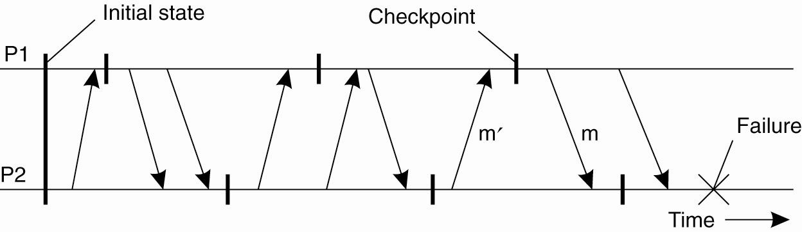
Independent Checkpointing
The domino effect – Cascaded rollback

Slide 62
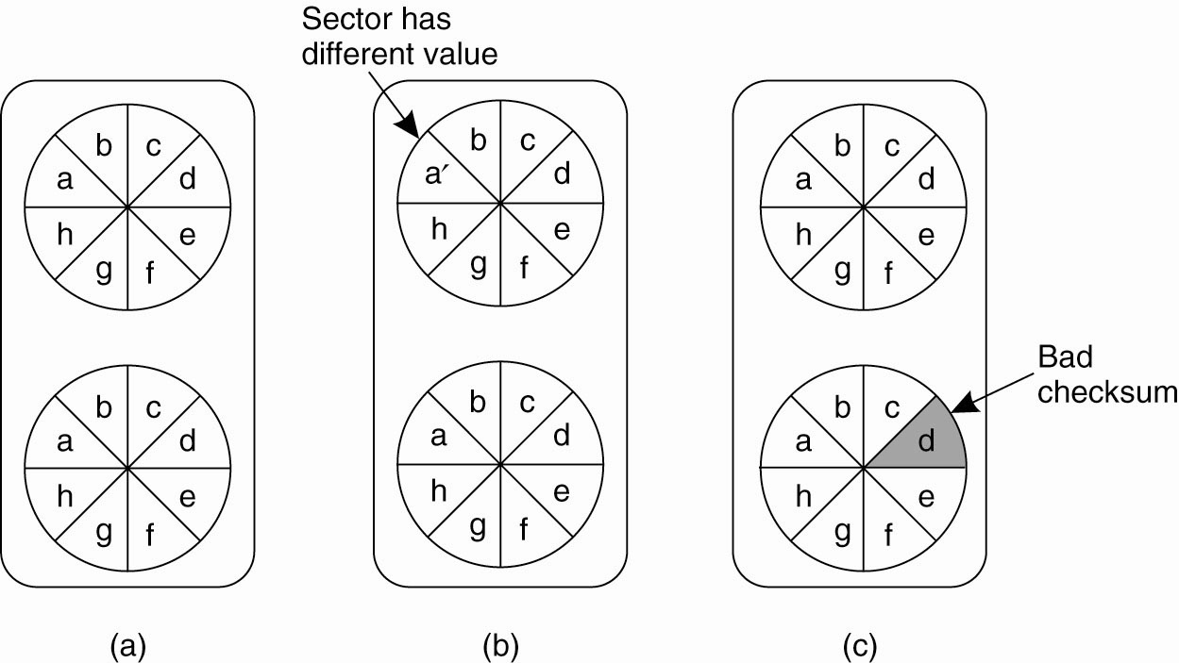
Recovery – Stable Storage
(a) Stable storage.
(b) Crash after drive 1 is updated.
(c) Bad spot.

Slide 63
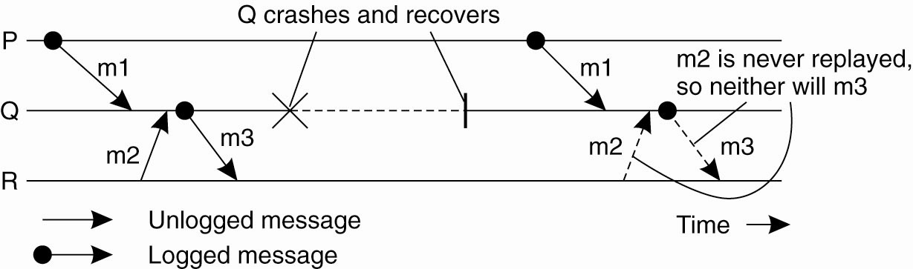
Characterizing Message-Logging Schemes
Incorrect replay of messages after recovery, leading to an orphan process

